Slide 1
Control flow and loops

Slide 2
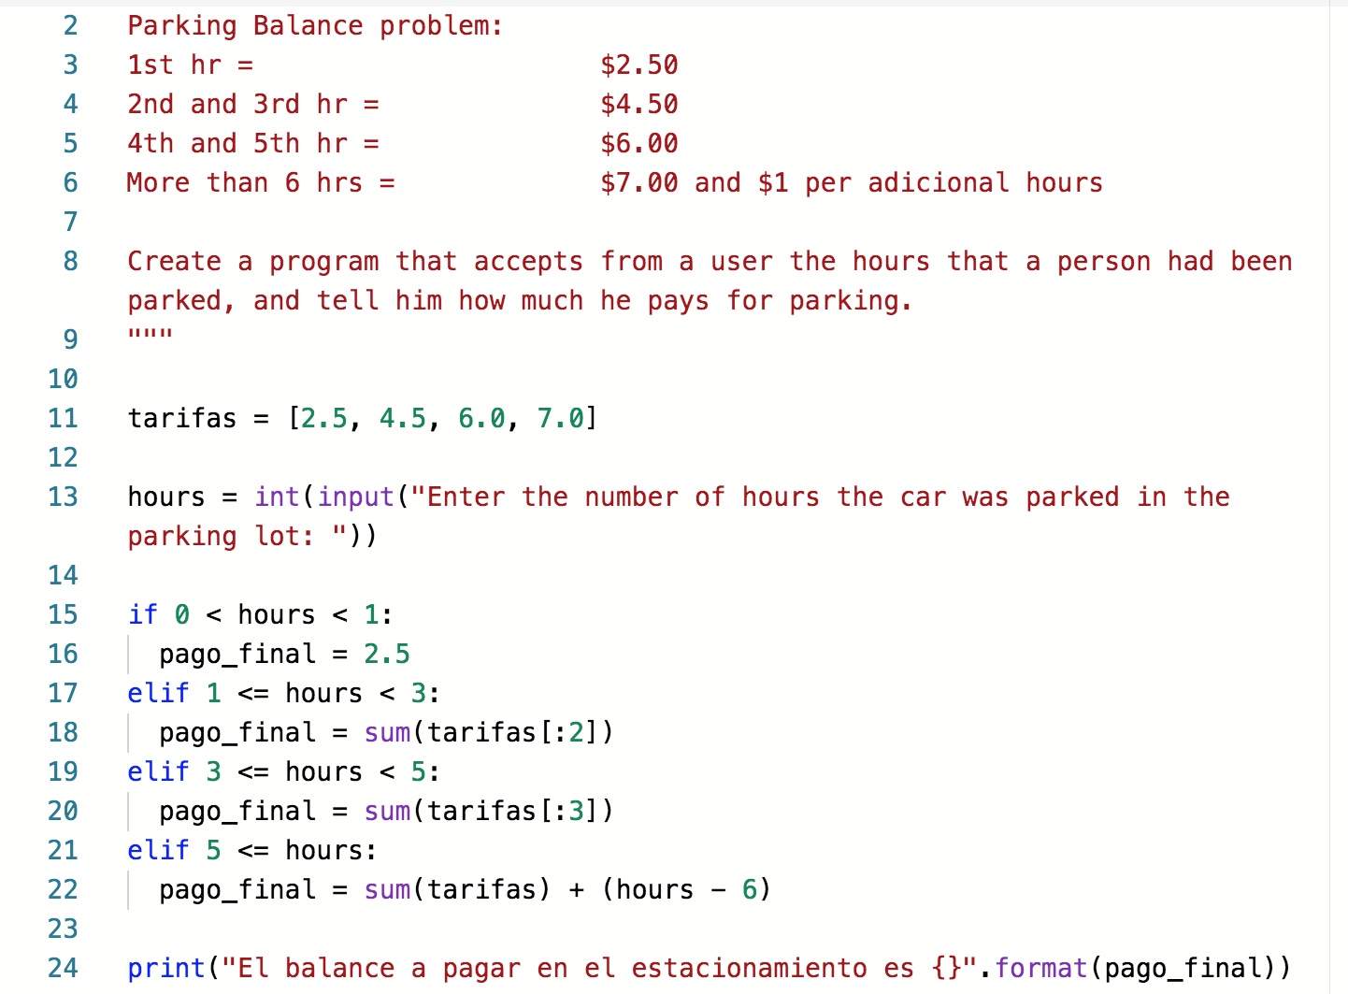
Parking Lot Problem (Review exercise)
Parking lot

Slide 3
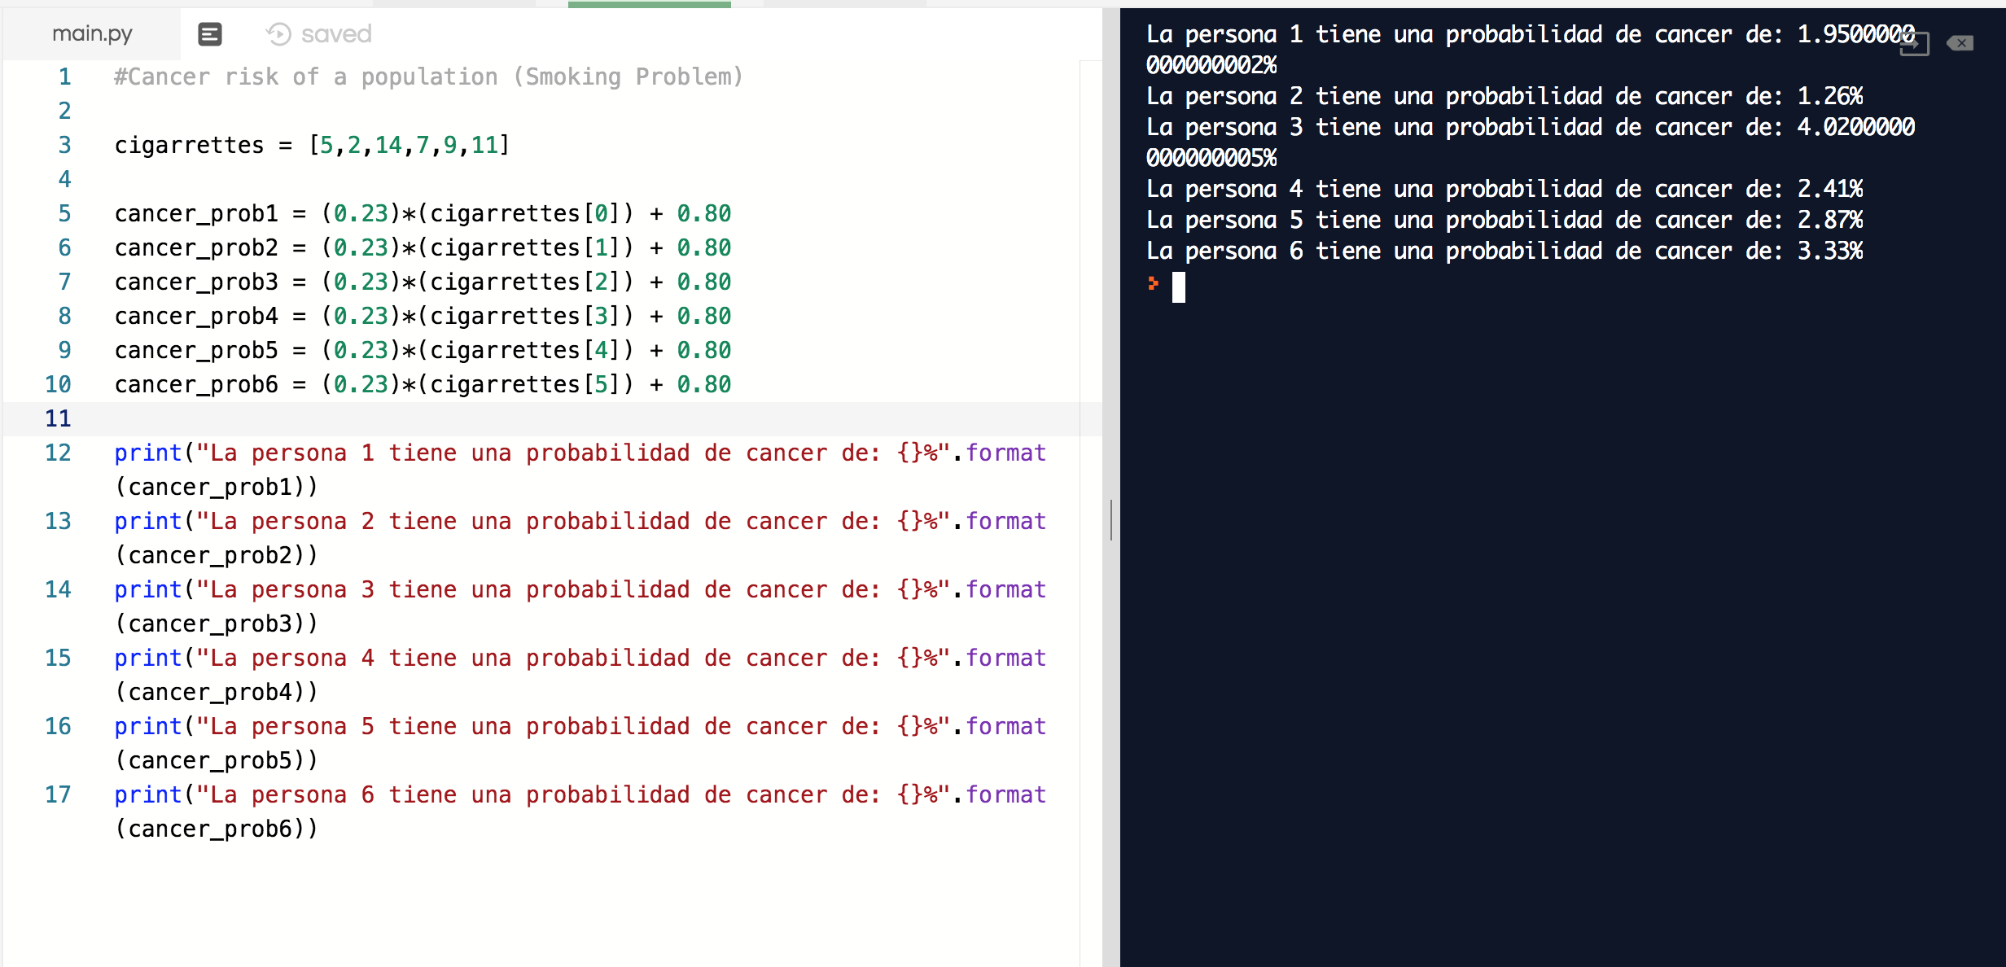
Smoking Problem(Cancer Risk) (review exercise)

Slide 4
Important points that we won’t Cover
Copying lists -> stackoverflow link
Uso de Diccionarios
Mas sobre tuplos
Conjuntos en Python

Slide 5
A quick review of list methods
List method Methods Purpose
list_name.append(a_value) adding an element at the end of a list
list_name.remove(a_value) removing first instance of a value in a list
list_name.insert(a_value, position) inserting a value in a particular position
list_name.extend(another_list) concatenating two lists
list_name.index(an_element) returns the index of an element in a list
del list_name[position of element] or del list_name[position1: position2] index deletion
New_list_name = list_name clonning a list
New_list_name = list_name[:] The easiest and quickest way to copy a list

Slide 6
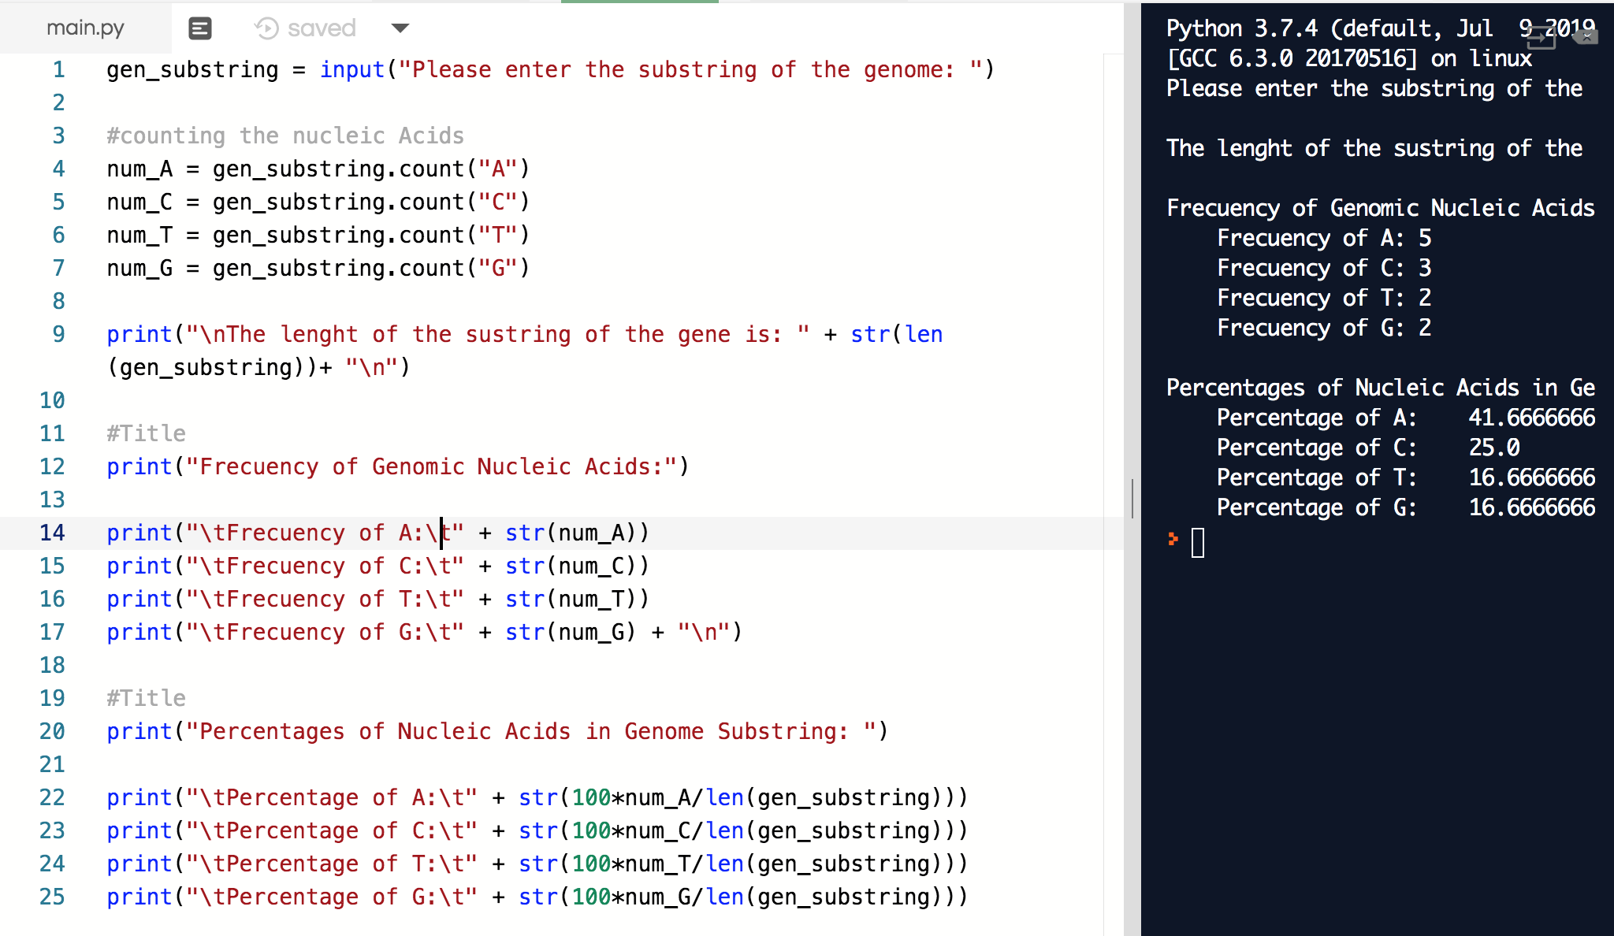
Lists and repetitive tasks examples(1)
Code comparison between previous genome frequency distribution program and genome frequency distribution program using loops.

Slide 7
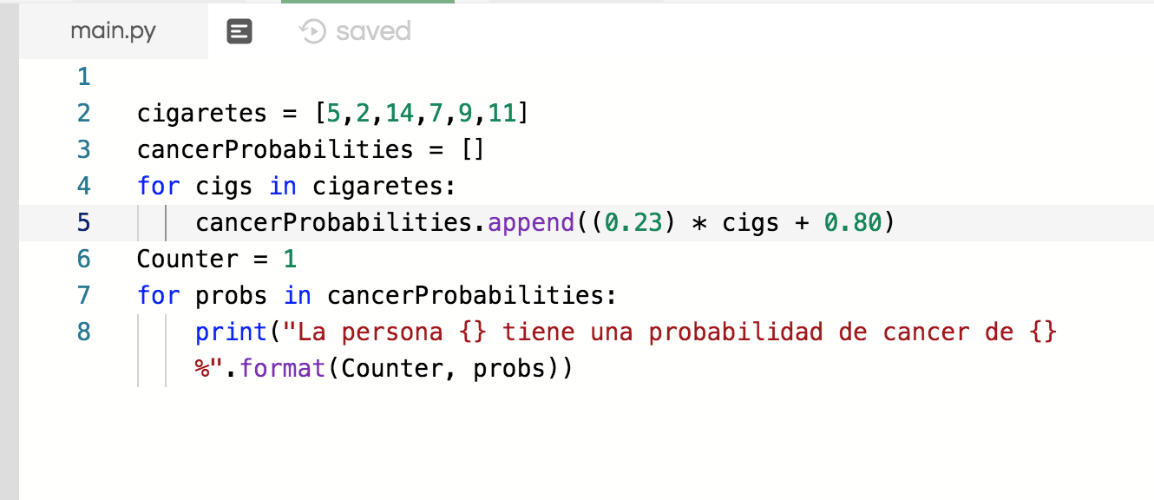
Lists and repetitive tasks examples(2)
Previous Smoking example

Slide 8
A fantastic solution to repetitive tasks: For Loops
Notice how the same examples we had worked with were easily simplified with a for loop
The sintax:
for item in a_list:
do something (Notice the indentation)
Lists and for loops are always used together
Given an integer value n we can create an ordered list of all the integers k such that 1<= k <= n, using the built-in function range(n)
e.g. print(range(5)) # this code would output the list [1,2,3,4,5]
range(n) and len(a_list) are sometimes used together when working with for loops
e.g. lista = [A,B,C]
for index in range(len(lista)): #for que imprime la lista al revés
print(lista [ len(lista) – index ] ) # el output seria C,B,A (verticalmente)

Slide 9
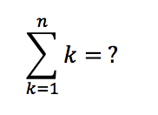
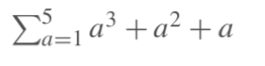
For loops and mathematics
For loops, logic and proofs
For loops are for sumations
E.g. Gaus trick’s sum:
E.g. of another sum:
For loops and complexity
Sums are used to analyze a for loop
Multiple sums are used to analyze multiple nested for loops

Slide 10
For loops and lists - Examples
E.g. Write a Python program to find the words that are longer than n from a given list of words. Print the list of such words. Sample List : ['abc', 'xy6z', 'aba555', '1221']
E.g. Write a Python function that takes two lists and returns True if they have at least one common member. (Requires the implementation of a nested for loop)

Slide 11



Fibonnaci Sequence
Definition: The Fibonnaci sequence is a sequence such that the term_n = term_n-1 + term_n-2 and the first two terms are1.
E.g. 1,1,2,3,5,8,13,21, … ∞
Existen algoritmos que extraen la secuencia fibonnaci de cualqueira de estas figuras:
Recommended link(for adults only - 18+!): https://www.youtube.com/watch?v=kVTPwPh7ioU&t=1493s

Slide 12


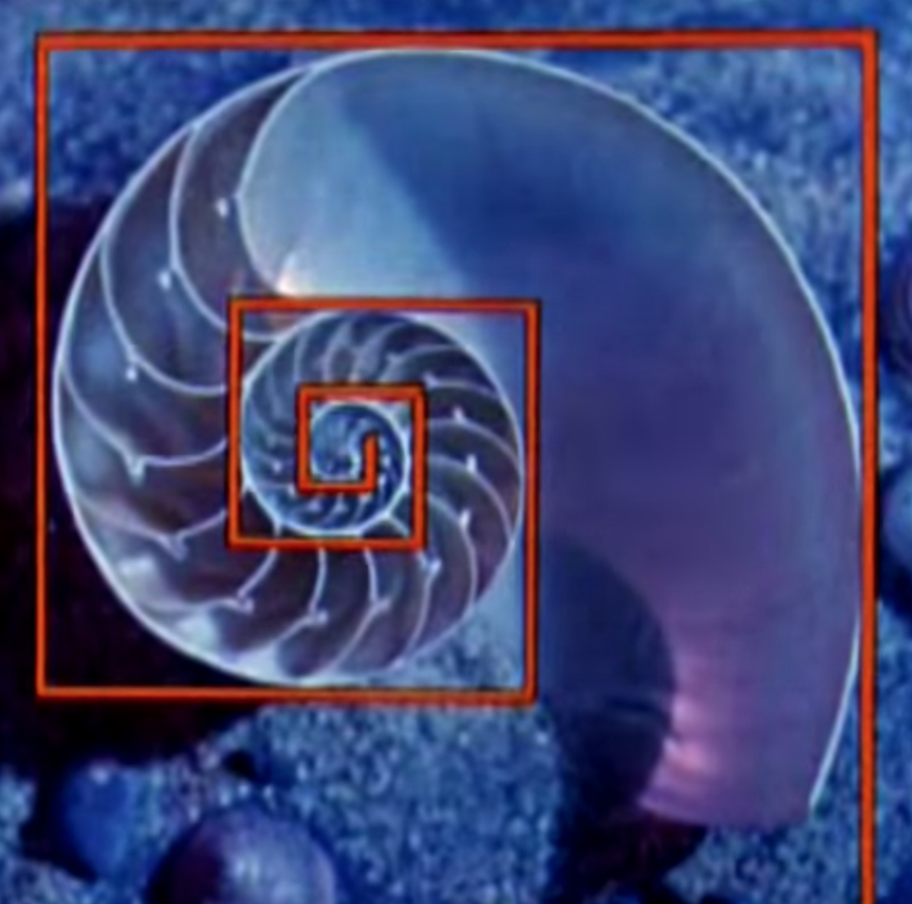
Fibonnaci sequence in nature

Slide 13

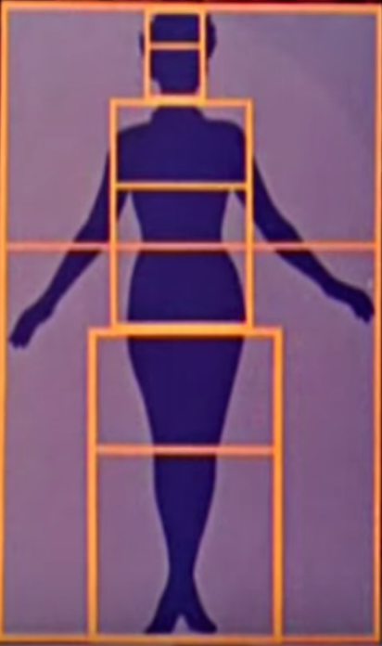
Fibonnaci in humans

Slide 14


Fibonnaci in human Creations

Slide 15
Programming the fibbonaci sequence
Repasar que es un variable acumuladora y una variable contadora
E.g. Given a natural number n, find the the term in the Fibonnaci sequence with position n.
E.g. Find the sum of the first n terms of the Fibonnaci sequence.

Slide 16
Before Fibonnaci lets talk about While Loops
Sintax:
While condition:
indented code that will be repeted while the condition is true
Used when the condition statements cannot be deduced from the iterable.
E.g. Given a list of desired groceries with another list of price label, find a list of groceries that the person can afford to buy.
While loops a great to use when we want to create a menu in a program.
E.g. Use the smoking problem, the BMI problem, and the previous problem shown in the slide to create a menu for a person to determine which of the three programs he would like to use.

Slide 17
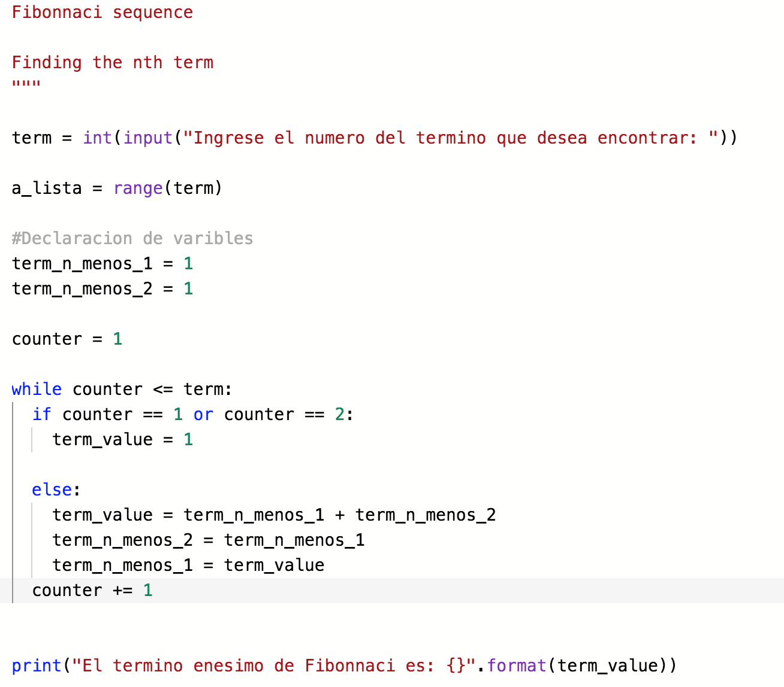
Fibonnaci in Code

Slide 18
Rotation of a list Example
We can rotate a list using for loops or while loops.
# Rotation of a list excercise
lista_original = input("Por favor ingrese una lista: ").split(",")
num_rotacion_usuario = int(input("Por favor ingrese un numero por el cual desea que la lista sea rotada: "))
contenedor_lista_rotada = lista_original[:] #declaramos las variable
num_rotacion = num_rotacion_usuario % len(lista_original)
contador = 0 #declaramos la variable contadora
while contador <len(lista_original):
contenedor_lista_rotada = lista_original[(len(lista_original)- 1 - num_rotacion + contador) % (len(lista_original)-1)]
contador = contador + 1
print(contenedor_lista_rotada)

Slide 19

Caesar’s Cipher
Recomended links: https://en.wikipedia.org/wiki/Caesar_cipher

Slide 20
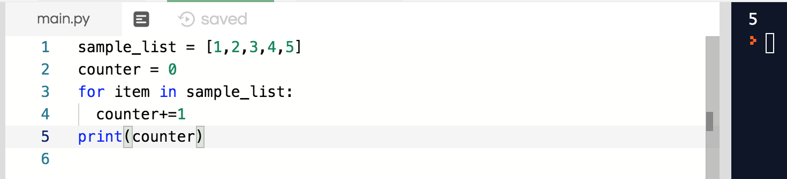
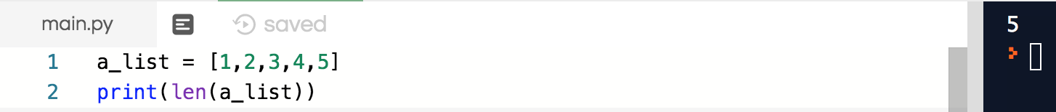
Purpose of functions
Functions have mainly 2 purposes: code recycling and legibility.
e.g. The len() function finds the maximum value in a list without us having to run the following code:
Notice how the previous code on the right is more legible than the previous code on the left.

Slide 21
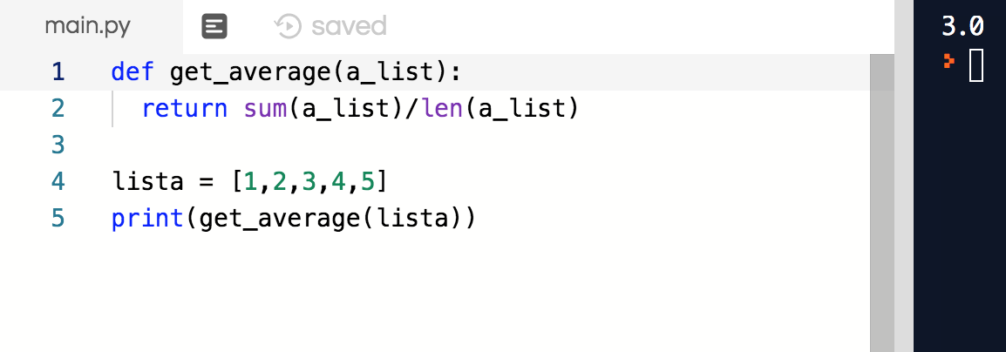
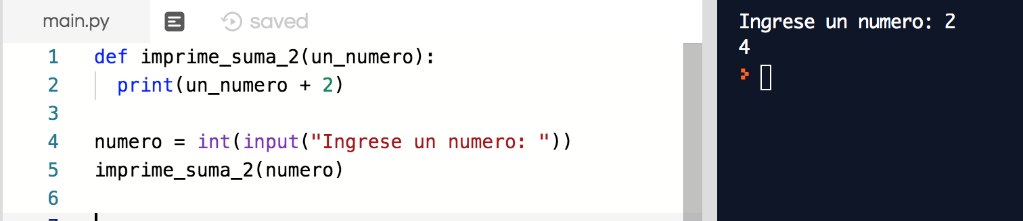
Types of function and syntax
There are 2 types of functions: built-in functions and custom made functions.
E.g. sum() is a built-in function
Built-in functions are created by whomever designed python. Custom made functions are designed by us using the following syntax:
def function_name(parameter1, parameter2, …, parameterN):
Indentation of the actions we wish python to do when the function is “called
E.g.
Remark: Functions must be defined before the first time we want to use them.
Among the custom made functions there are two types of functions: the ones that return a value to where they are “called” and the ones that don’t return a value.
Notice how the previous code on the left uses a return clause while the previous code on the left does not.

Slide 22
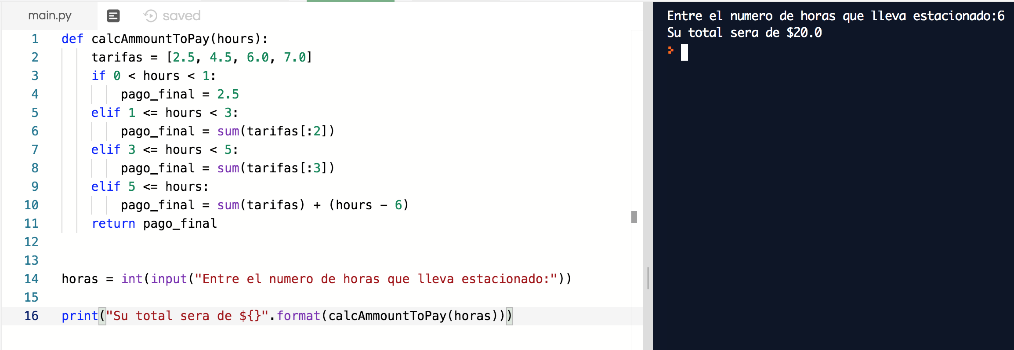
Parking lot example using functions

Slide 23
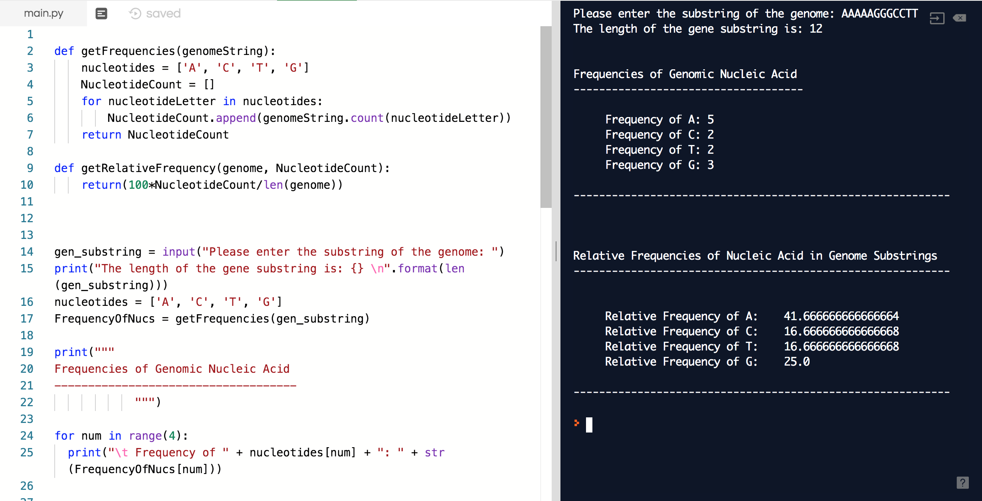
Genome Frequency with functions

Slide 24
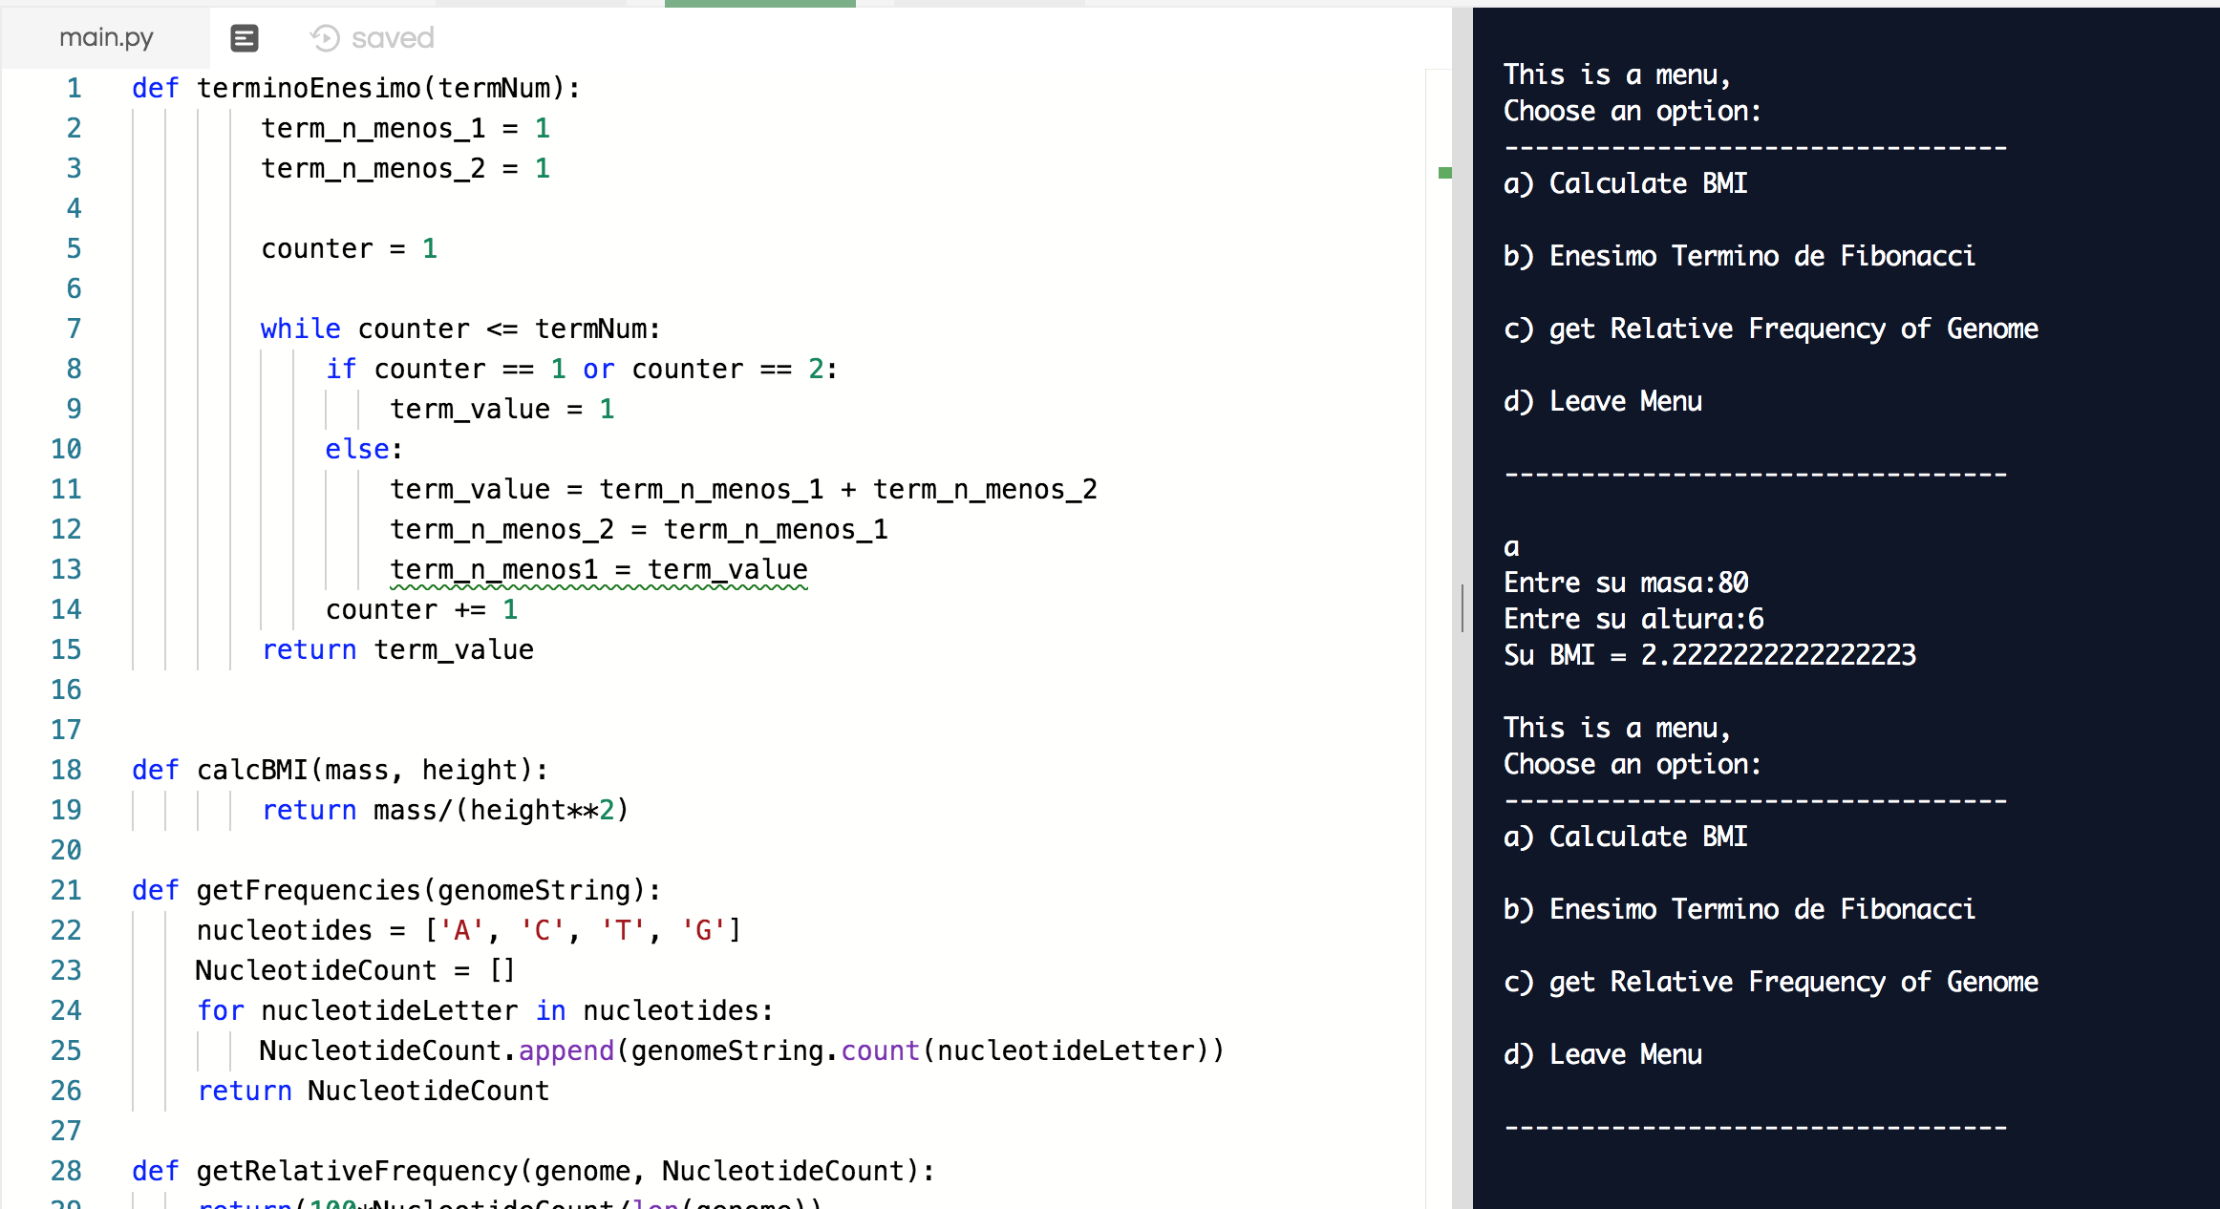
While menu and function example

Slide 25
Recursive functions
Def: A recursive functions is a function that “calls” itself.
E.g. Calculating n!
E.g. Finding the nth term of the Fibonacci sequence

